Slide 1
GearsUp Ecommerce
C372 Graded Assignment

Slide 2
Table of contents
01
02
03
04
05
Introduction
Problem & solution
Audiences
06
Payments
Regulations
Consideration
Prototype

Slide 3
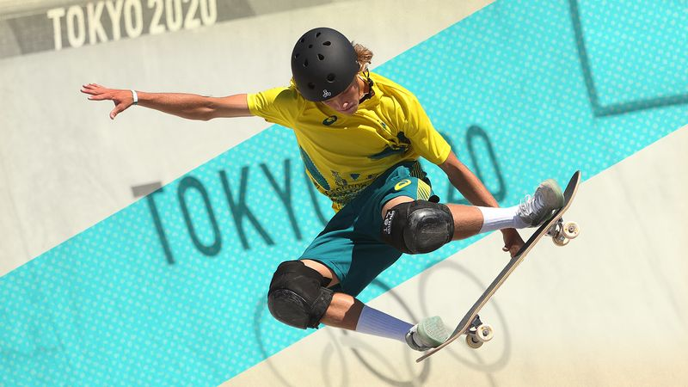
01
Introduction

Slide 4

What is GearsUP?
In Gears Up, I believe that everyone wants to own their very own sports gear/equipment. No matter if you are a veteran or a rookie, we offer wide range of brand and sports equipment.
Why choose us?
Wide selection: From basketball, hiking to swimming, we have everything you could ever ask for your favourite activity.
Competitive Price: We thrive to give you the cheapest price within the market and giving many great deals.
Quality Assurance: We source from the trusted brands, ensuring you can use the gears for long.
Join us to Gear up

Slide 5
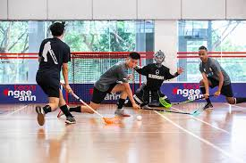
02
Problem & Solution

Slide 6
Problems:
Solution:
Sport e-commerce website such as SF sports have their own specialty sport such as volleyball only or badminton only
The price of the well-known brand equipment are quite pricey
Difficulty in cross-border purchases
We have wide variety of sports, name us any and we will have it. Such as bouldering, swimming, boxing, volleyball, and more
We aim to get you the best offer in our website from our supplies and giving u the real deal at low price
Cross-border e-commerce is growing and allow us to reach globally.

Slide 7
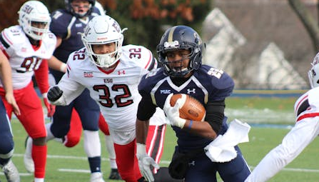
03
Audiences

Slide 8
Our Target Audience:
Anyone who wants to:
Own sports equipment
Buy as a gift for someone
Buy as a bundle for training
Just display it
Basically, anyone can buy from us

Slide 9
Underserved Audience:
Those who have limited budget since the brands are well-known therefore it tend to be more expensive than the non-well brand
Who have no cashless payments
Individuals with disabilities

Slide 10
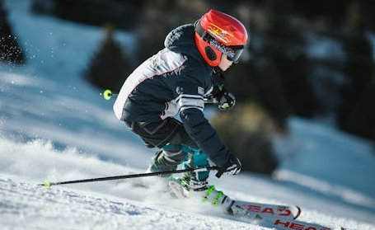
04
Payments

Slide 11
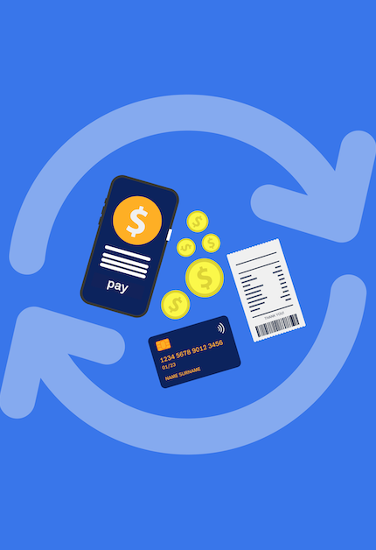
Payment Issues:
Cross-border transaction issues (Maybe like people from overseas can't buy certain stuff from other country due to the payment gateway issues)
Not much payment method (some people might want to use credit cards, paypal, netsQR etc)
Unable to pay in one go, needing instalment to buy products

Slide 12
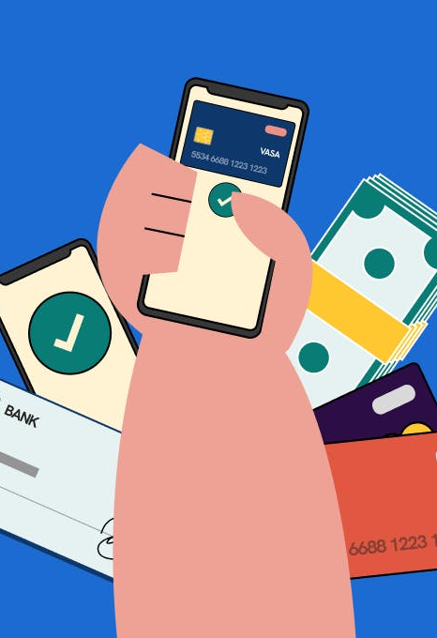
Payment Solutions
PayPal for International Payments
Allows overseas customers to buy easily.
Despite higher transaction fees, it ensures global accessibility and trusted security.
NETs payment
Able to scan the code payment using different bank account if they enable NETs QR payment
Wide acceptance in Singapore
Cost effective as it have lower transaction fee
Future Growth Plans
Consider integrating local BNPL services (e.g., Atome, Grab PayLater) to provide more options.

Slide 13
05
Regulations

Slide 14

Account holders are responsible for safeguarding their account information and reporting unauthorized transaction.
We don’t store user’s payment details (their account, password etc) (PDPA)
Secure payment processing
Using tokenization by converting the sensitive details (payment details) into tokens to reduce exposure to hackers
Encryption of the account details (using SHA1 to encrypt their password)
Monitoring any suspicious Money laundering activities

Slide 15

06
Prototype

Slide 16
Prototype || 23031029 || Graded Assignment

